Slide 1



How to determine the RAM size in mongodb ?
What is Journaling?

Slide 2

MongoDB Operators

Slide 3
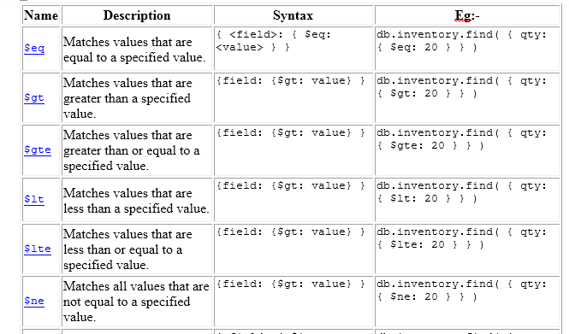
Query and Projection
Comparison Operators

Slide 4
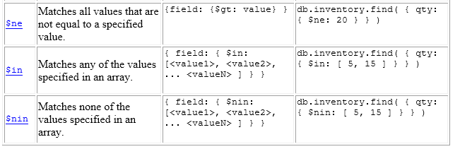
Comparison Operators

Slide 5
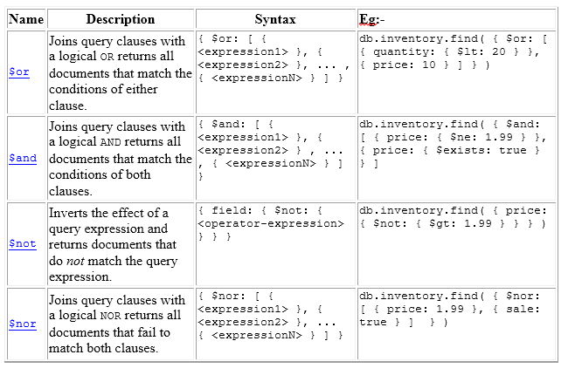
Logical Operators

Slide 6
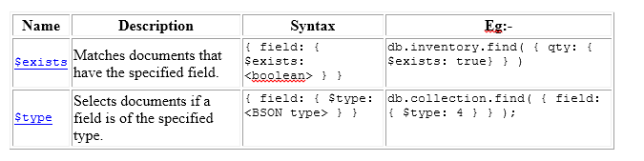
Element Operators

Slide 7
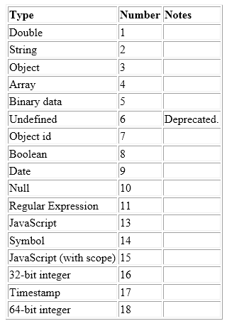
Data Types

Slide 8
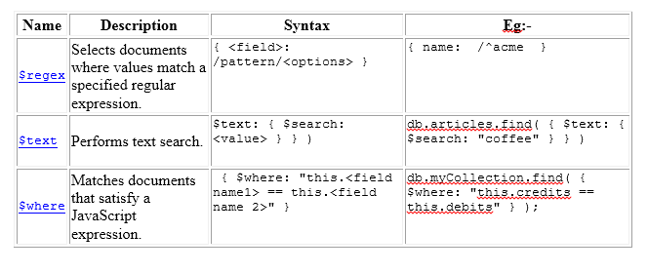
Evaluation

Slide 9
Considerations Of Using $where:-
Do not use global variables.
$where evaluates JavaScript and cannot take advantage of indexes. Therefore, query performance improves when you express your query using the standard MongoDB operators (e.g., $gt, $in).
In general, you should use $where only when you can’t express your query using another operator.

Slide 10
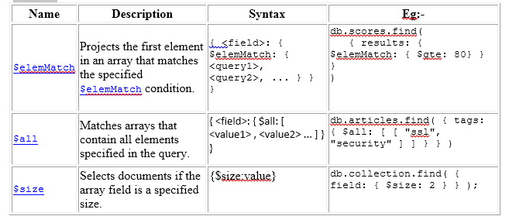
Array

Slide 11
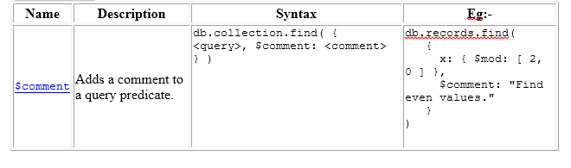
Comments

Slide 12
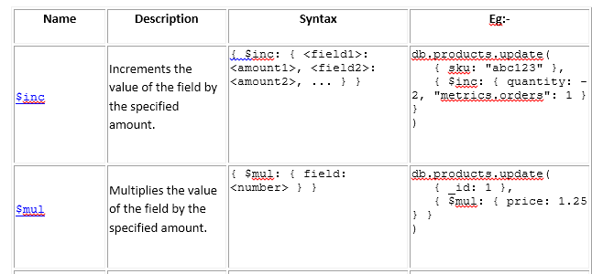
Update Operators
Fields:-

Slide 13
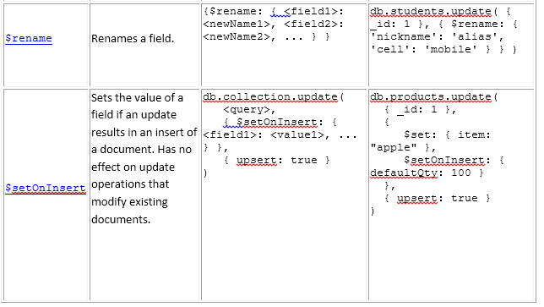
Fields

Slide 14
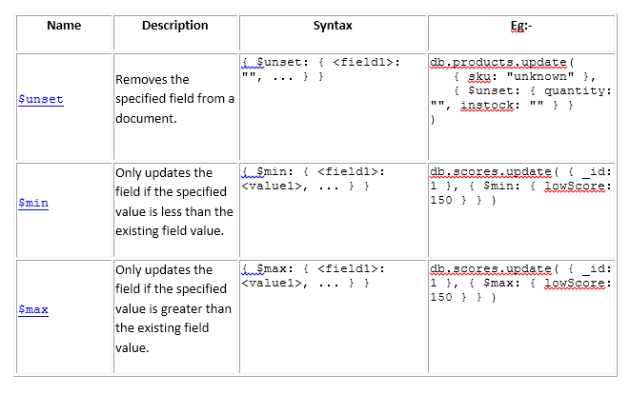
Fields

Slide 15
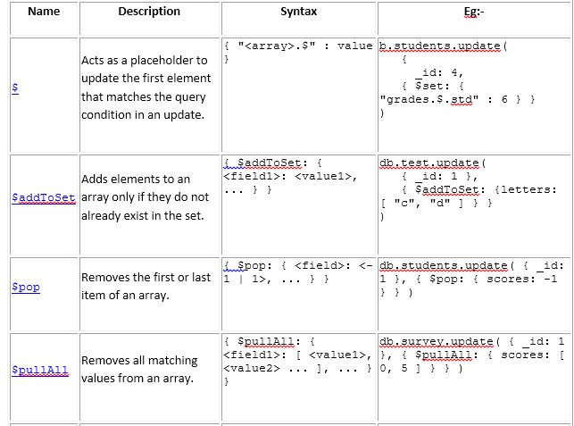
Array

Slide 16
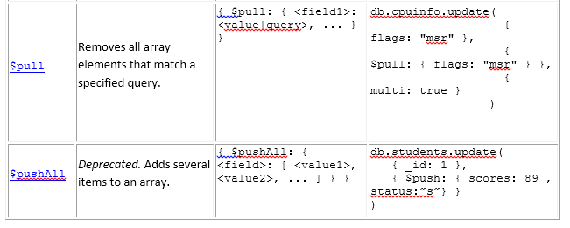
Array

Slide 17

Practice all the operators with sample data

Slide 18
Thank you for your attention!

